Slide 1
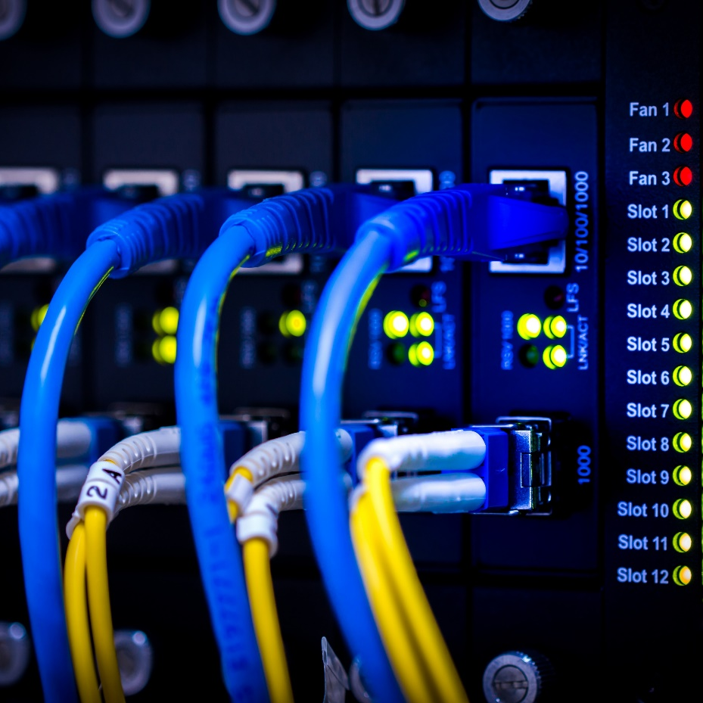
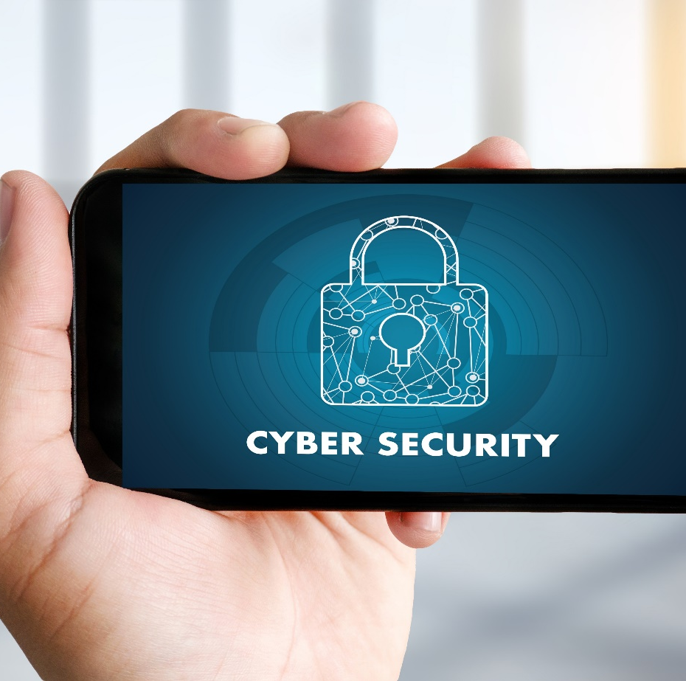
Cyber exercise (analysing an attack related to a specific threat)
09
10
2024

Slide 2
Introduction to incident handling

Slide 3
Incident Handling definitions
Start of the scenario
A security incident encompasses a range of events that may indicate a threat to an organization's security.
A security alert is derived from security events that are logged by the systems in an organization.
Security Event: Any log message related to security, such as authentication logs, firewall logs, etc.
Security Alert: One or more events flagged by the SIEM solution as possibly suspicious. These can be either true positives or false positives.
Security Incident: A security alert that has been validated as a genuine threat.
It's important to differentiate between a security incident and a security breach. A security breach is a type of security incident that specifically involves verified unauthorized access or exploitation, impacting the confidentiality, integrity, or availability of systems, services, networks, or data. While breaches often involve data compromise, they can also encompass other forms of security compromise, such as the unauthorized usage of systems, the installation of malware, or the disruption of operational services.

Slide 4
INCIDENT HANDLING
Incident Handling
Events. Alerts. Incidents.
Precursors. Indicators.
An event is any observable happening
Each log entry is an event
Alerts are events which match a specific condition
Incidents are violations or an imminent threat of violation of security policies
Indicators
An incident may have occurred or is occurring.
Precursor
An incident may occur in the future, for example a vulnerability disclosure
Events
Incident
Alerts
Notes:
Besides the differences between incident management, incident handling and incident response, it is important to understand the nuances between alerts, events and incidents.
An event is any observable happening. For example each log entry is an event.
Alerts are events that match a specific condition. Incidents are violations or an imminent threat of violation of security policies.

Slide 5
Managing Incident Response
Start of the scenario
Planning and Preparation
Detection and Reporting
Assessment and Decision
Responses
Lessons Learned

Slide 6
Managing Incident Response
Start of the scenario
Planning and Preparation | Detection and Reporting | Assessment and Decision | Responses | Lessons Learned
Development and documentation of strategic IR policies | Monitor | When did the event happen? | Containment | Create an Incident Report
Establish communication guidelines | Detect | How was it discovered? | Eradication | Post-Incident monitoring
Incorporate threat intelligence feeds | Alert | Have any other areas been impacted? | Recovery | Identify preventative measures
Perform threat hunting exercises | Report | What is the scope of the compromise?
Backups |  | Has the point of entry been discovered?

Slide 7
detecting an incident
Incident handling
Security Alerts
Security tools
IDS, AV, Firewall
Sigma rules
Threat intelligence
Human report
Helpdesk
System administrator
Other teams
CSIRT
LEA
Regulatory bodies
Threat Hunting
Sophisticated attacks have different steps
Attackers blend in
Living of the Land
Signature bypass
Unknown techniques
Anomaly detection
Correlation
Human factor
Know your assets
Connecting the dots
Notes:
During the preparation phase, organizations attempts to limit the number of incidents that will occur by selecting and implementing a set of controls. However, residual risk will inevitably persist after these controls are implemented. Detection of security breaches is thus necessary to alert organizations whenever incidents occur. This detection can be done via security alerting or by threat hunting.
Security alerts allow for the real-time or semi real-time detection of security incidents and can be triggered by
• Security tools
• Human reports
• Other teams, including notifications from law enforcement agencies and regulatory bodies
Not every security incident sets of alerts. Sophisticated attacks have different steps and attackers often try to blend in with normal organizational activities. These more sophisticated attacks can be detected via threat hunting.
All this will then result in an incident report, or notification, that gets send to the CSIRT. This notification is the start of our scenario.

Slide 8
Incident Registration
Start of the scenario
Ensure completeness of the report
Incident Report
Registration
Triage
Further Process
When did it start?
What triggered the incident report or how was an incident detected?
Is it a reliable source? Quality of the source?
Where was it detected?
What is the severity and impact?
Impact on availability, integrity or confidentiality?
PII. Safety? Criminal act?
Notes:
When an incident report is received, it should be registered and triaged. Registration of incident reports will most often be done in an automatic fashion, for example by creating a ticket in a ticketing system or by creating an alert in a case handling system.
After the registration process, the incident handler needs to verify if the incident report is complete. The goal is to ensure that the incident report contains all the information needed to start the further process

Slide 9

Triage (1)
Validating an Incident Before Triage
Is this a genuine threat or attack?
Was the attack successful?
What was the outcome of the attack on the affected system?
How severe is this threat?
Does this threat grant the attacker network access?
Are other systems at risk as well?
Notes:
The answers to these questions provide the input for the triage of the incident report. Triaging means that you do not handle the incoming reports first come, first served but that incidents are handled based on their priority and severity.

Slide 10
Triage (2)
Not First Come First Served
Is it really a security incident?
Relevant for your team?
In your constituency?
Previously reported to your team?
What is the impact and severity of the incident?
Escalation, notification or legal requirements?
Categorize the incident
After the registration, categorize the incident so you can use a correct incident response plan or playbook
Notes:
The answers to these questions provide the input for the triage of the incident report. Triaging means that you do not handle the incoming reports first come, first served but that incidents are handled based on their priority and severity.

Slide 11
Victim Information
Sector
Region
Legislation
Contact
OES?
Other CSIRT?
Role
Offices
Central or main branch
Mandate, authority
Responsibility
Threat Actors
Public Reports
Incidents
MITRE
Victim
Press
Sector
Changes in legislation
Affecting the victim
CSIRT Network
Compile knowledge
Notes:
Discuss with the students the type of victim information that needs to be included in the bundle.
• In which sector and region is the victim operating?
o Is it an Operator of Essential Services (OES)?
o Is the report from the main / central office or from a regional branch?
• Under which legislation will you have to operate?
o Do you have the mandate to operate?
o Is another national / government team responsible?
• Who will be your primary contact?
o What is the role, mandate, authority and responsibility?
o Does your contact have executive powers towards IT?
o But also influence on the victim’s board?
Complement the victim information with relevant threat information. Start a new group discussion and keep a reference to the ATT&CK framework for describing the threat actors

Slide 12

Preserve evidence
Inform the victim first
No reboot. Do not run security software
Do not start or stop services or applications
Do not change user configuration
Do not tip off the attacker
Assume communication is breached
Collection
Outweigh balance between evidence collection and risk of tampering material
Have a standard method for collecting evidence
Notes:
Discuss with the students some general advice to give to victims after reporting an incident:

Slide 13

Evidence: Chain of Custody
Audit trail
Validating collection, storage, movement and protection of evidence.
Was everything handled correctly?
Is the source known?
Ensure no modifications can take place.
Label everything
Case and item identification. Location. Date. Tools.
Document everything
Timestamps. Conditions. Expected outcome and actual outcome.
Notes:
An audit trail (often referred to as chain of custody or chain of evidence) is the process of preserving the integrity of the digital evidence. The audit trail includes all steps of the investigative process but is especially important for seizing and preserving evidence. Every evidence needs to be tracked from the moment it was seized, until the moment it was destroyed, including everyone who had access to the evidence.

Slide 14
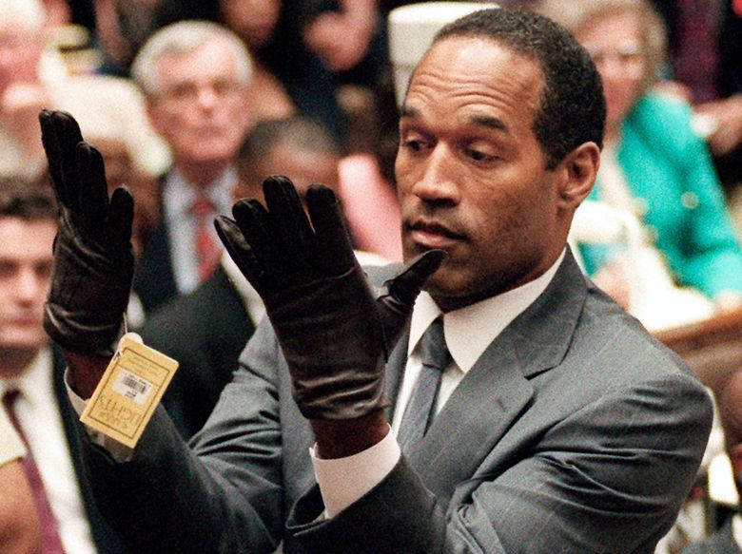
Evidence: Chain of Custody
The O.J. Simpsons case: June 12, 1994
Sloppy forensic evidence collection
Cross – contaminated evidences
“Missing blood”
Holding evidence in unsecured environment
Fingerprint not collected
Notes:
https://www.crimemuseum.org/crime-library/famous-murders/forensic-investigation-of-the-oj-simpson-trial/

Slide 15
CTI and Iranian threat actor

Slide 16
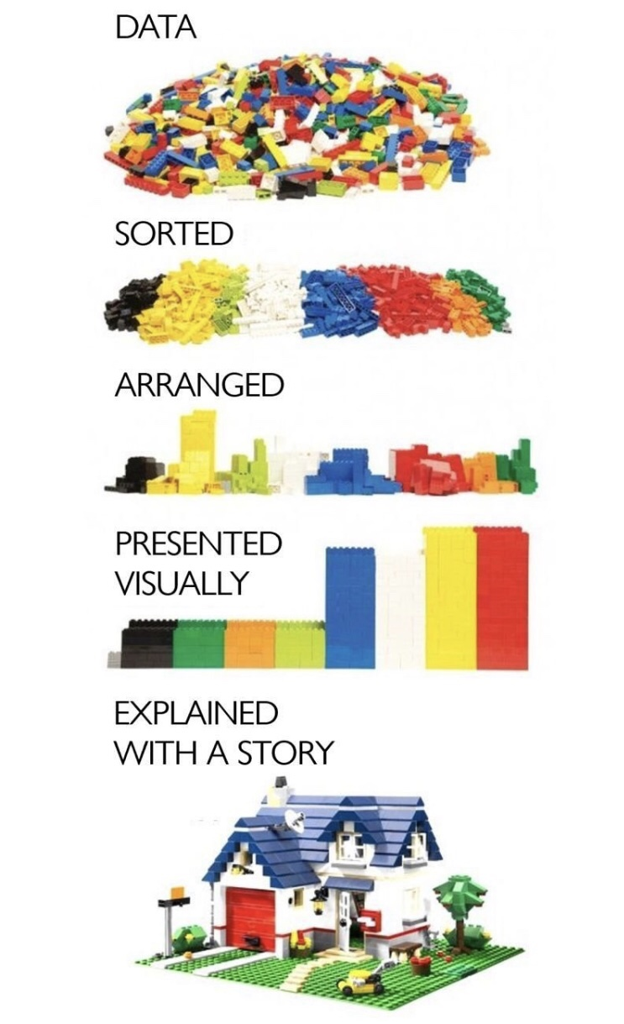
Threat intelligence
Adversary Emulation
APT actor
Malware name / family
BTC address
IP
File Hash
Notes:
Threat intelligence is any knowledge that allows security professionals to prevent or mitigate any known attacks. It holds information on who these attackers may be, their motivators, and what they could be capable of if they accessed the system. In addition to this, threat intelligence can provide examples of IoCs to look out for in your system.

Slide 17
TTPs
Adversary Emulation
Tactics
Techniques
Tactics are defined as what the attacker does.
Techniques best describe what the attacker uses to accomplish their goal.
Procedures
Procedures are the manner, or order, in which an attack is carried out.
Notes:
The tactics used by a threat actor or group describe the way the attacker operates throughout the different stages of the cyber kill chain. Different attackers, advanced persistent threat (APT) groups, and criminal organizations often rely on methods that they have honed over the years to successfully compromise a target.
When analyzing an attacker or a threat group, the tactics describe more of the high-level approach that they take. The techniques start to narrow the methods used to carry out the attack.
Attackers and threat groups often stick with what works for them. More sophisticated attackers hone their skills over several years and create certain procedures for conducting a successful attack; much like a business creates a procedure on how to successfully accomplish a task.

Slide 18
About CTI
Adversary Emulation
Sources:
Open Source (Shodan, Virus Total, Google, Malpedia)
Free Subscriptions
Paid subscriptions
Own data collection
Collaborations, memberships
Types of CTI:
Strategic CTI
Tactical CTI
Technical CTI
Operational CTI
CTI is NOT a brainless collection of all data available!
The use of a TIP (Threat Intelligence Platform) can either help you or drive you away from your goal. Be wise.
Notes:
https://github.com/jaegeral/security-apis

Slide 19
MITRE ATT&CK Overview
Adversary Emulation
The MITRE ATT&CK framework is a standardized knowledge base of Adversary Techniques, Tactics & Common Knowledge.
Tactics
Techniques
Sub-Techniques
Techniques are categorized into 14 different tactics, which progress from pre-attack to impact and data exfiltration.
Techniques describe the actual activities an attacker might perform in order to reach their goals.
Many techniques in the MITRE ATT&CK framework consist of multiple sub-techniques that describe different ways to carry out each technique.

Slide 20
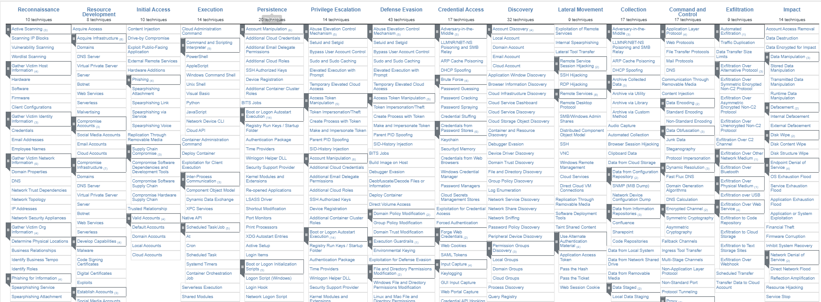
MITRE ATT&CK Overview
Adversary Emulation

Slide 21
OilRig, APT34, Twisted Kitten, Crambus, Helix Kitten, Crimson
Adversary Emulation
Motivation: state sponsored
Goals: espionage
Target: mainly Middle-East, but in addition: Turkey, Albania
First sight: 2014
Target sectors: Academic/Research Institutes, Commercial Aviation, Energy, utilities & mining, Financial services, Government & public
services, Healthcare, Industrial manufacturing, Insurance, Transportation & logistics
APT34 has conducted reconnaissance aligned with the strategic interests of Iran
Notes:
https://apt.etda.or.th/cgi-bin/showcard.cgi?g=OilRig%2C%20APT%2034%2C%20Helix%20Kitten%2C%20Chrysene&n=1
https://attack.mitre.org/groups/G0049/
https://malpedia.caad.fkie.fraunhofer.de/actor/oilrig

Slide 22
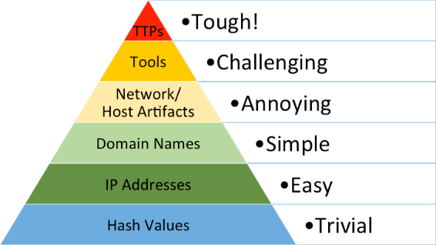

Scenario
Adversary Emulation
Advanced adversary
How an adversary operates
TTPs: Tools, Techniques, Procedures
Not as concrete as indicators of compromise (IoCs)
Understand current exposure
Assess detection capabilities
Tactics: Why
Techniques: How
Notes:
The scenario is built around adversary emulation. Adversary emulation is an activity where security experts emulate how an adversary operates. The ultimate goal is to improve how resilient the organization is versus adversary techniques. Both red and purple teaming can be considered as adversary emulation.
Although the terms are often mixed, emulation isn’t the same as simulation. Emulation is impersonating a real threat actor, based on its observed activity. Simulation is about an adversary which is not real. Explain to the students the difference of the two terms.
Adversary activities are described using Tactics, Techniques & Procedures (TTPs), using a Unified Kill Chain . TTPs are not as concrete as for example indicators of compromise (IOCs), but they describe how an adversary operates at a higher level.

Slide 23
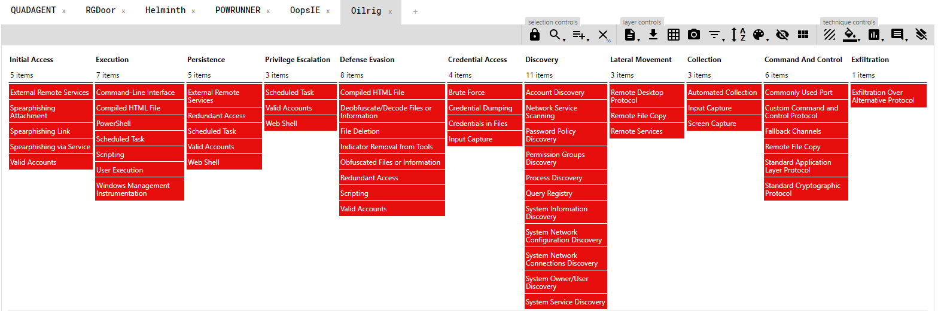
Adversary
Adversary Emulation
Adversary
OilRig
Notes:
* Victim: Chapt 17: Copyright rules
* Adversary: Chapt 18: Adversary Emulation Plan
-- Operations, software used, emulation plan with techniques, based on information from APT reports (Figure 188 fe)
OilRig is a suspected Iranian threat group that has targeted Middle Eastern and international victims since at least 2014. The group has targeted a variety of sectors, including financial, government, energy, chemical, and telecommunications. It appears the group carries out supply chain attacks, leveraging the trust relationship between organizations to attack their primary targets. FireEye assesses that the group works on behalf of the Iranian government based on infrastructure details that contain references to Iran, use of Iranian infrastructure, and targeting that aligns with nation-state interests.[1][2][3][4][5][6][7]
https://attack.mitre.org/groups/G0049/

Slide 24
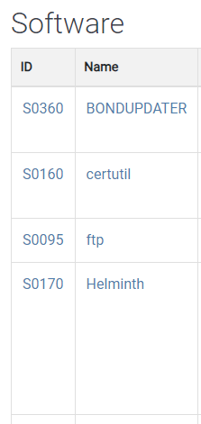
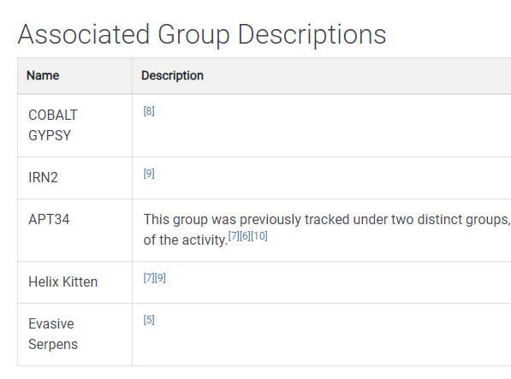
OilRig
Multiple threat intelligence organisations following this group and therefore multiple names.
Notes:
BONDUPDATER
BONDUPDATER is a PowerShell backdoor used by OilRig. It was first observed in November 2017 during targeting of a Middle Eastern government organization, and an updated version was observed in August 2018 being used to target a government organization with spearphishing emails.[1][2]
certutil
certutil is a command-line utility that can be used to obtain certificate authority information and configure Certificate Services. [1]
ftp
ftp is a utility commonly available with operating systems to transfer information over the File Transfer Protocol (FTP). Adversaries can use it to transfer other tools onto a system or to exfiltrate data.[1][2]
Helminth
Helminth is a backdoor that has at least two variants - one written in VBScript and PowerShell that is delivered via a macros in Excel spreadsheets, and one that is a standalone Windows executable. [1]

Slide 25
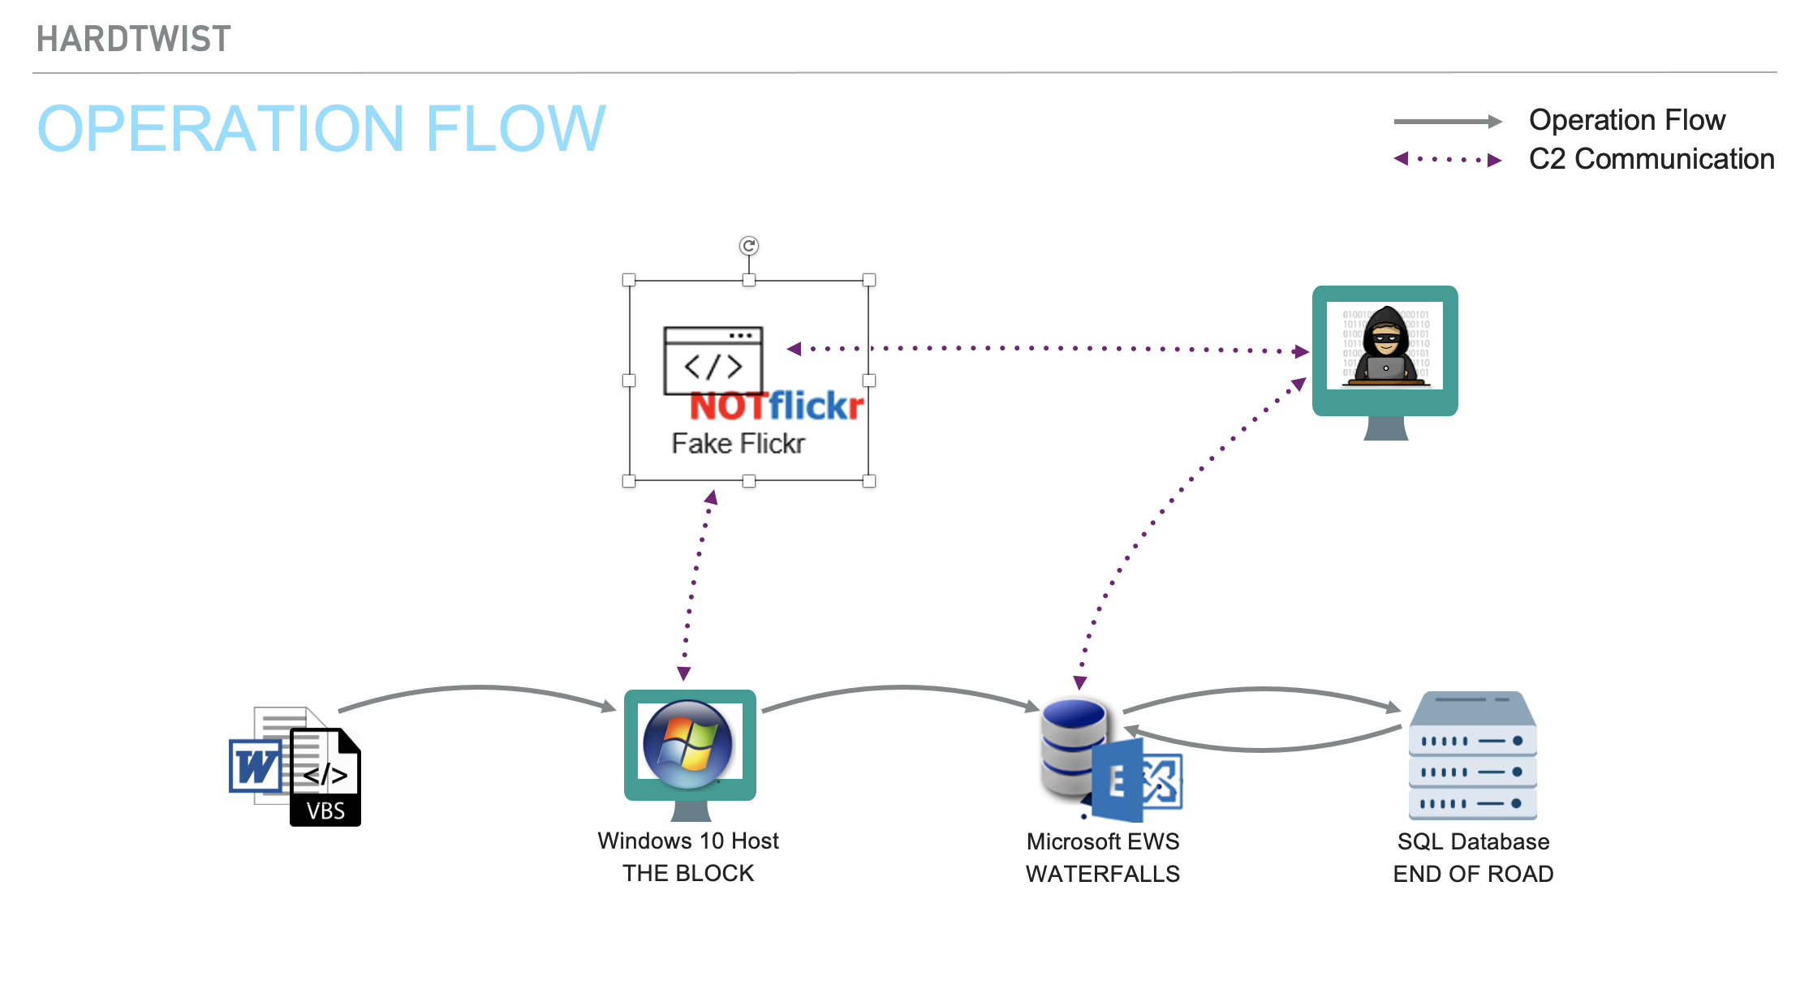
Operation FLOW

Slide 26
Tools needed for today

Slide 27
Tools
https://github.com/Lensver65/ESDC-BP

Slide 28
The Story

Slide 29



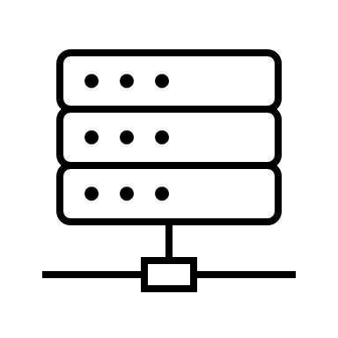
Step 1
User receives a SpearPhising email with a malicious attachment…
Once the attachment is opened, the malware runs and reports back to C&C

Slide 30
Step 1
Base64 encoded text → SideTwist Malware
VBS in doc creates scheduled task, writes the base64 text to file in the localappdata\SystemFailureReporter\ directory as b.doc (file actually is executable)
Has basic Sandbox evasion technique
b.doc is renamed as „SystemFailureReporter.exe” and is scheduled to run every 5 minutes
Executable connects to X.X.X.X
TASK 1:
Use the LINK of „GGMS Overview.doc” (from GitHub) and have it analysed with VirusTotal and HA. Do the same with the „SideTwist.exe” file
Q:
What is the verdict?

Slide 31
Demo
See the macro
Domo the weaponisation
I’m only a script kiddie’
Start VMs
Start control server
Execute SideTwist malware
Binaries are available on the server: http://192.168.0.5/marketing_materials.zip

Slide 32
Q: Task 1
What are the hashes of the „b.exe” file?
MD5: a59b8539af98a6a6df7af4a771d05ea5
SHA-1: 0188756ec0173ba6af6c51551521997a316e588b
SHA-256: 9a080bb47fab612597fcb8d31b85f95fc080ed23ca86f75422a73b3f632a1e06
What is the comment „jinfantes” made on VT about the file „update.xml”?
„Iran’s APT34 Returns”

Slide 33
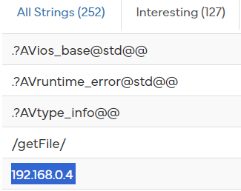
Q: Task 1
GetUserNameW
GetComputerNameW
TerminateProcess
OutputDebugStringW
UnhandledExceptionFilter
IsDebuggerPresent
GetComputerNameExW
GetModuleHandleW
What APIs are called by SideTwist?
What is the IP of the C&C server?
192.168.0.4

Slide 34
Step 2
Enumeration of the current user, accounts, groups, system information, network connections, processes, services, and if remote desktop is enabled.
Low privilege credential dumping
SystemFailureReporter.exe to download VALUEVAULT (the executable for which is b.exe) which is then leveraged to perform a low privilege credential dumping. SystemFailureReporter.exe then uploads the VALUEVAULT dump (named *.dat) back to C2 via HTTP POST request.

Slide 35
Step 2
TASK 1:
Use the LINK of „b.exe” (from GitHub) and have it analysed with VirusTotal and HA
Q:
What is the verdict?

Slide 36
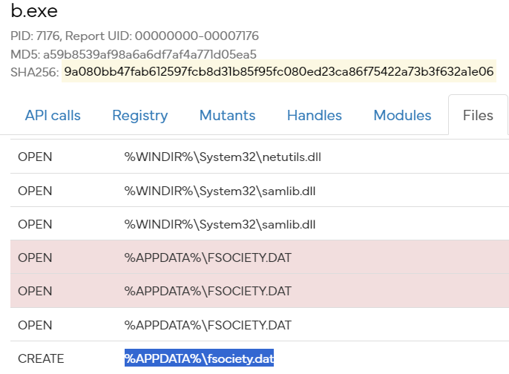
Q: Task 2
What is the name of the file created?
%APPDATA%\fsociety.dat
What is the name of the xml file embeded in b.exe?
Hash: a73f26a8d504043f785d7360e8febf2eeb8522ec873a0d4dd5d1d4bfd1e67d3d
Name: 1.xml (among others)

Slide 37
Step 3
Lateral movement
It has been discovered from the credentials dumped in Step2 that the user logged in the Victim has admin privileges on the EWS server
Installing webshell to remote server
Downloading the TWOFACE webshell (named contact.aspx) via SystemFailureReporter.exe; TWOFACE is then copied from the victim to SERVER and hidden with attrib + h.

Slide 38
Step 3
TASK 1:
Use the LINK of „contact.aspx” (from GitHub) and have it analysed with VirusTotal
Q:
What is the verdict?

Slide 39
Final challenge
Create a threat report about this threat actor!
Include:
Executive summary
Description
IOCs
TTPs
Mitre ATT&CK Framework references
Recommendations
Target Audience:
Your SOC ppl

Slide 40
references
This scenario is based on the Adversary Emulation Library created by Center for Threat-Informed Defense for education purposes.
https://github.com/center-for-threat-informed-defense/adversary_emulation_library/
Full attack scenario is available: https://github.com/center-for-threat-informed-defense/adversary_emulation_library/blob/master/oilrig/Emulation_Plan/README.md

Slide 41
Thank you for your attention
European Union Agency for Cybersecurity Vasilissis Sofias Str 1, Maroussi 151 24
Attiki, Greece
+30 28 14 40 9711
info@enisa.europa.eu
www.enisa.europa.eu

